Slide 1
Chess Heaven
-An awesome web application for chess management and betting-

Slide 2
This application is based on
Express NodeJS – Back End
Angular JS – Front End
MongoDB - Database

Slide 3
How to start the app
First of all you need to start mongoDB Database by executing the following command in cmd considering you already configured the environment variables: “mongod.exe –dbpath %mydatabasepath%”.
Second, in another instance of cmd, you will cd to the root folder of the app and execute: “grunt serve”. Now the app will run in localhost port 3000. You can open it by going to “localhost:3000”. If you don’t have any account logged in you will be redirected to the login page, otherwise you will go directly into the “main thing”.

Slide 4
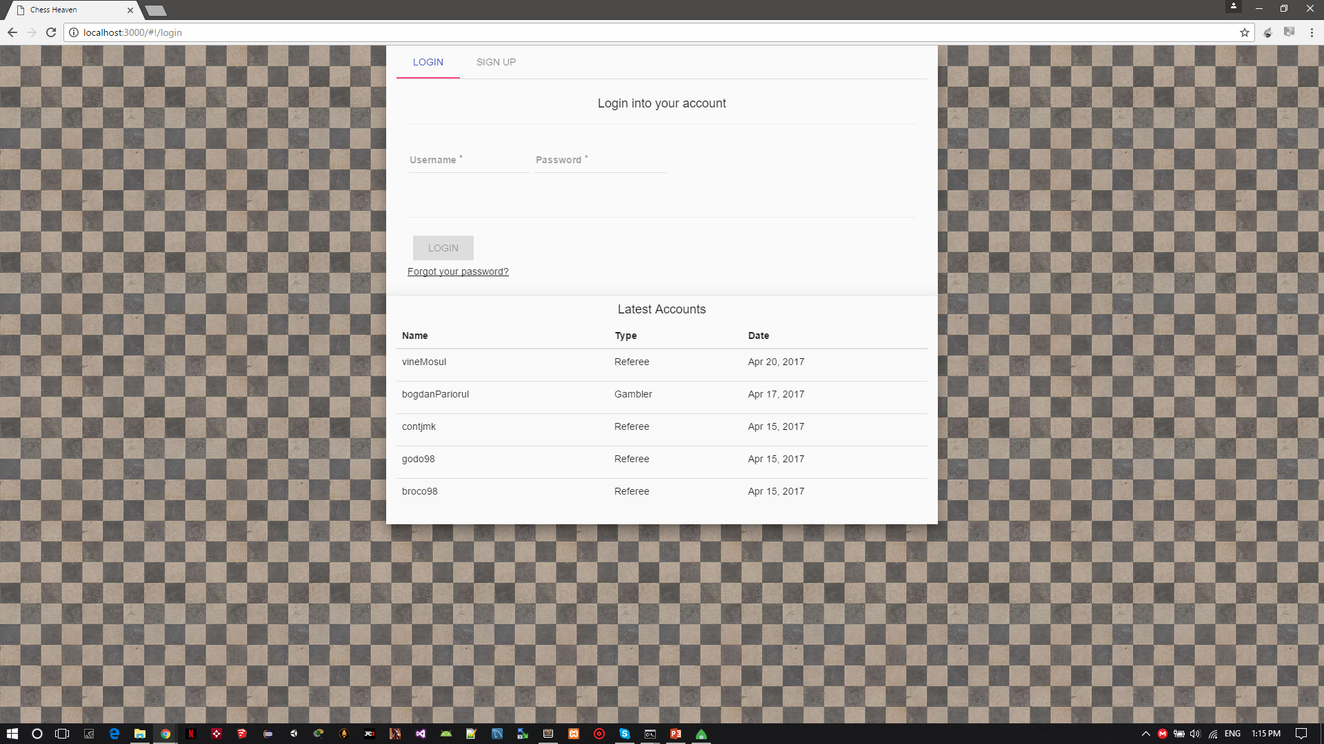
Login page
Here you can login if you already have an account or you can go to “Sign up” tab to create a new account.
Also there are listed the latest accounts.
Don’t click the “forgot your password?” button!!

Slide 5
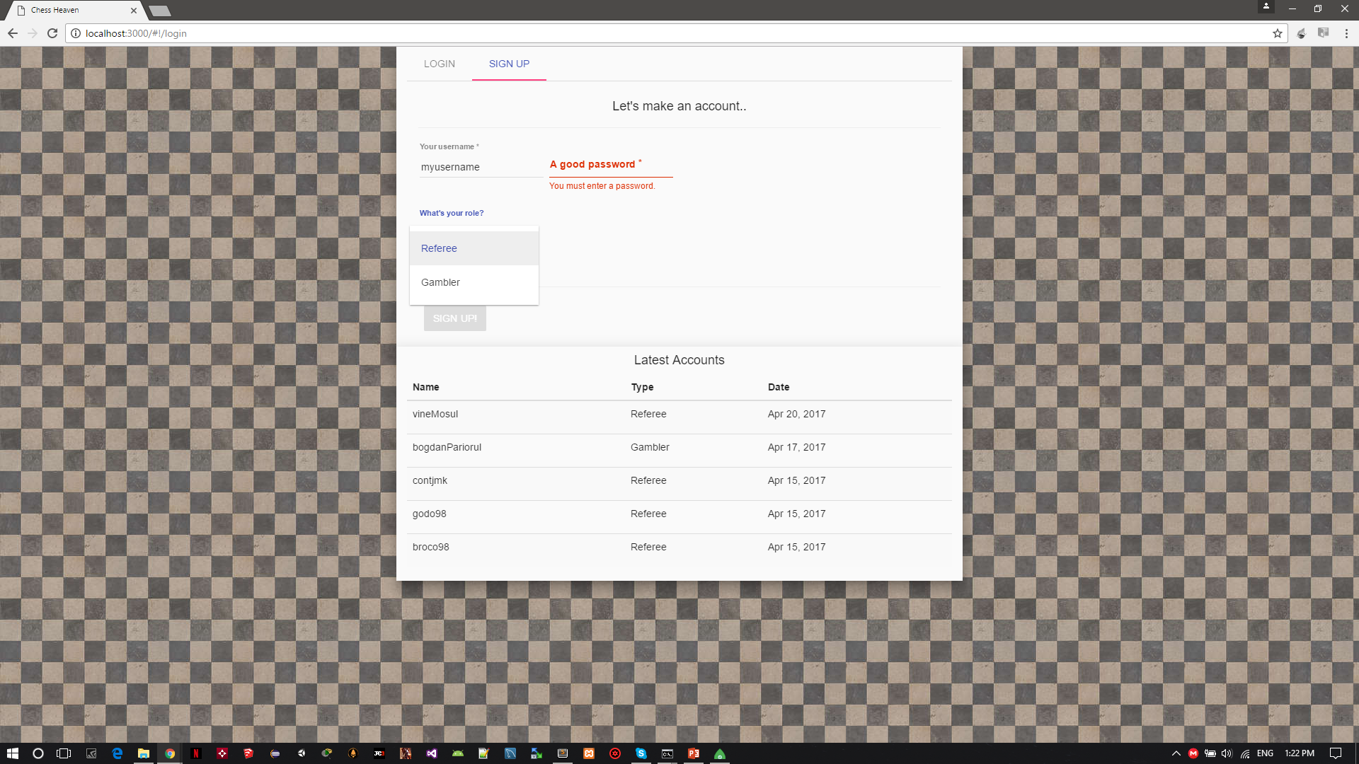
Creating an account
When you create your account you must write your username and password, also you must choose a role, default is “Referee”.
Depending on your role when you’ll login you’ll have different interfaces.

Slide 6
Referee’s view

Slide 7
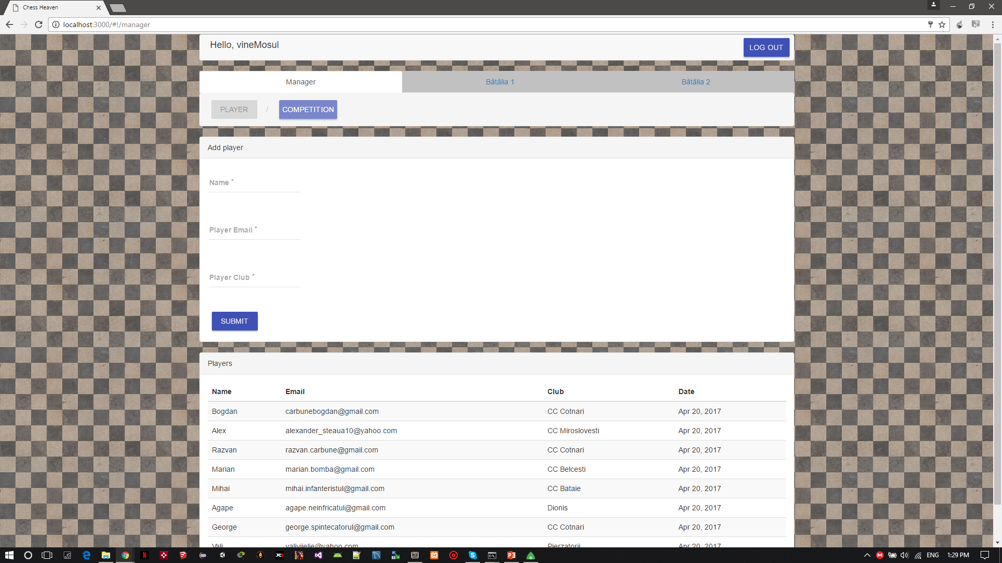
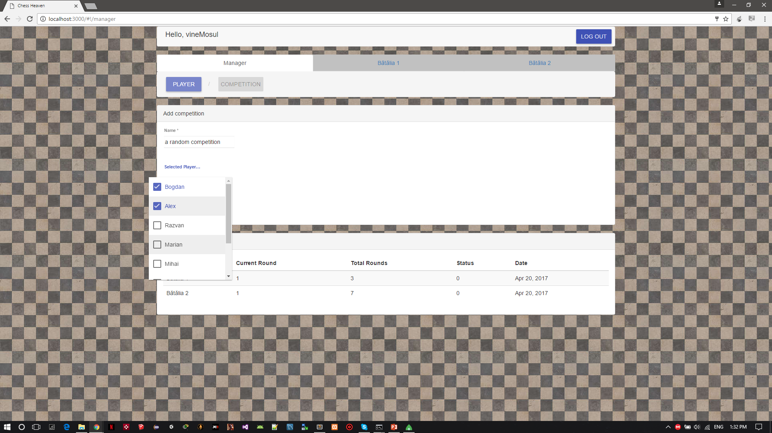
Manager Page
“Player” Tab- here you can add players for further competitions, you must write a name, an email and a club.
“Competition” Tab- here you create the competitions by entering a competition name and select the desired players. After you submit the new competition, the games will be generated by berger system.

Slide 8
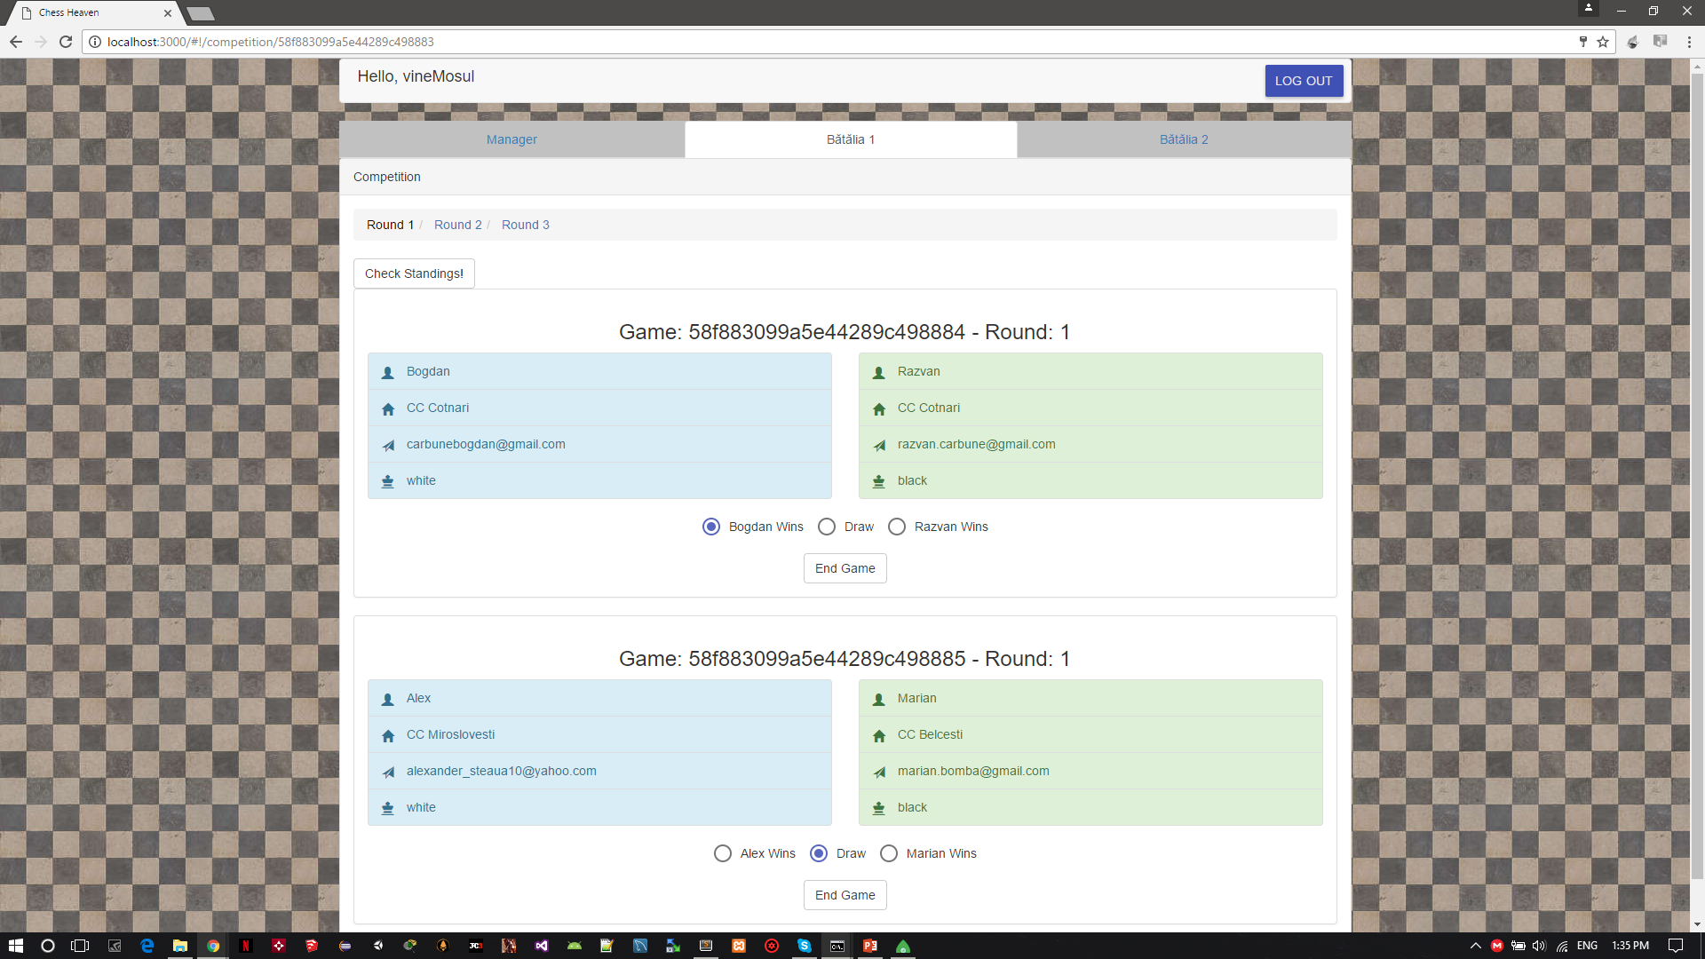
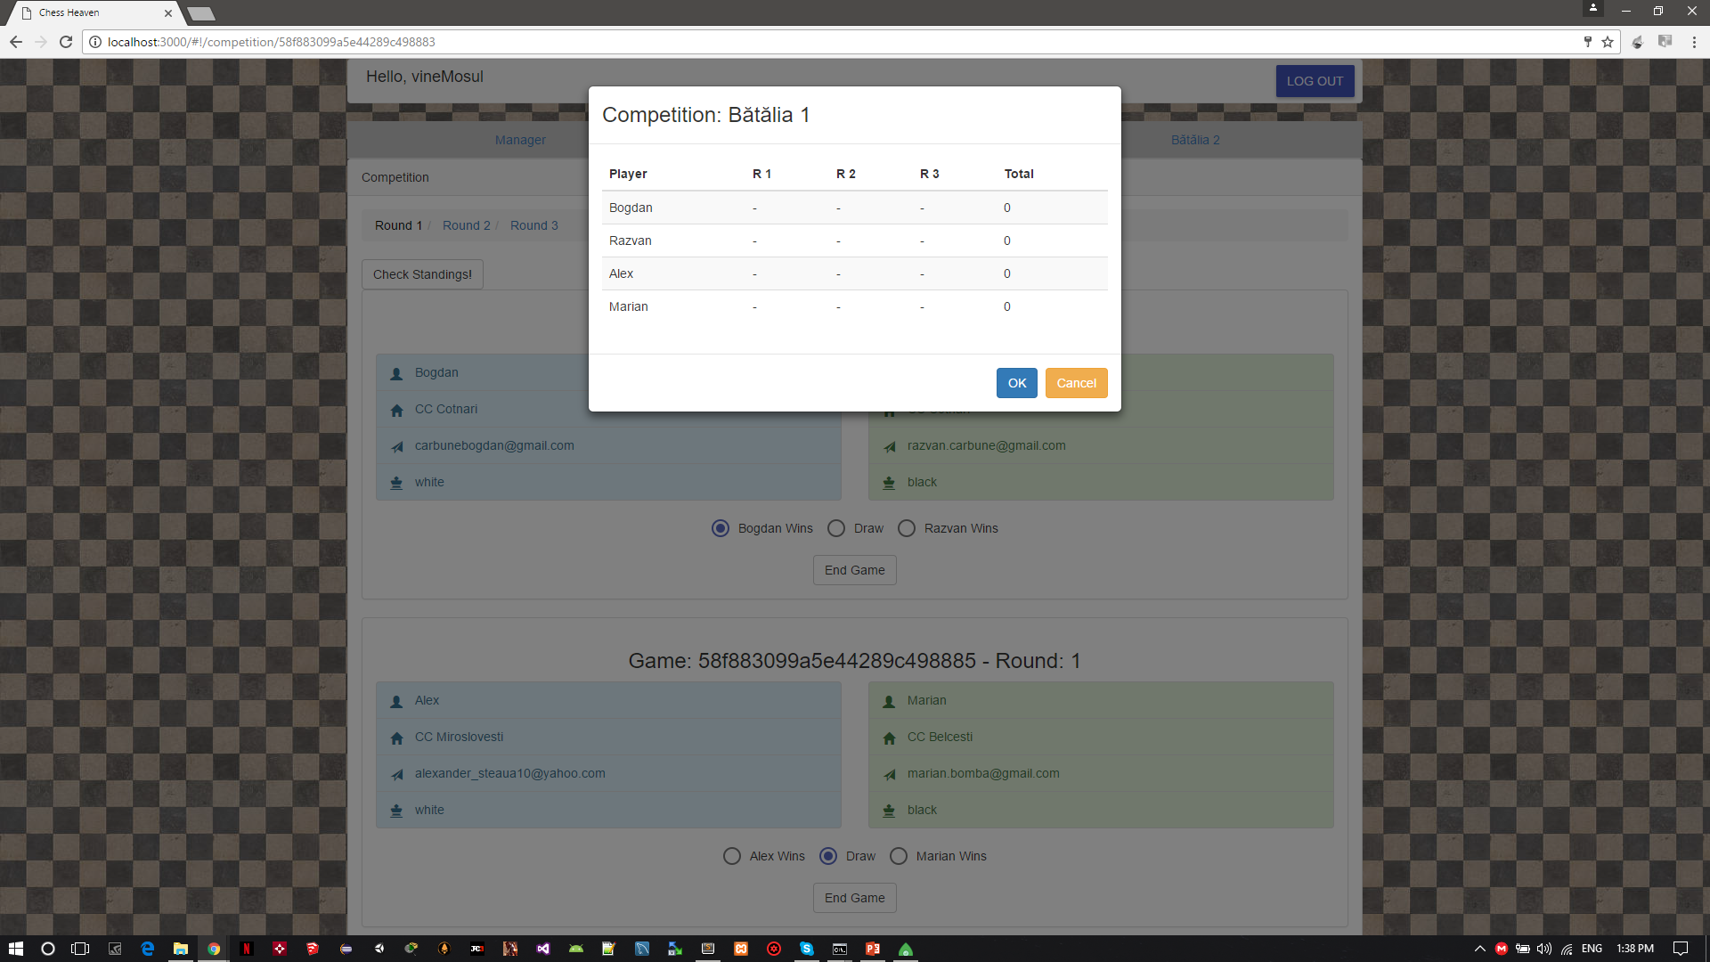
Competition Page
Here you are able to see all games from the selected competition filtered by rounds, you can end games after you choose the result
By clicking “Check standings” button a modal will pop up showing the status for each player from current competition.

Slide 9
Gambler’s view

Slide 10
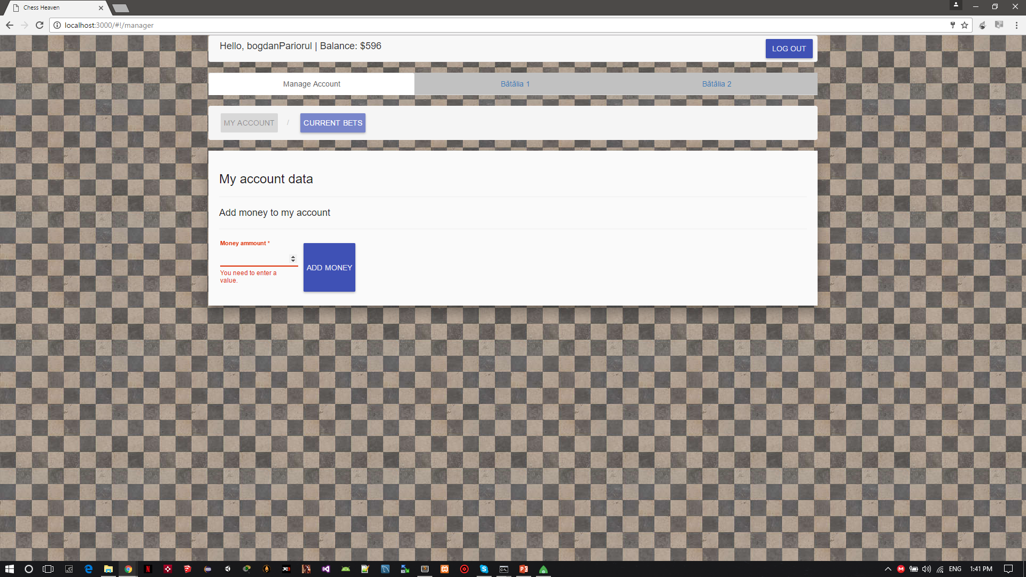
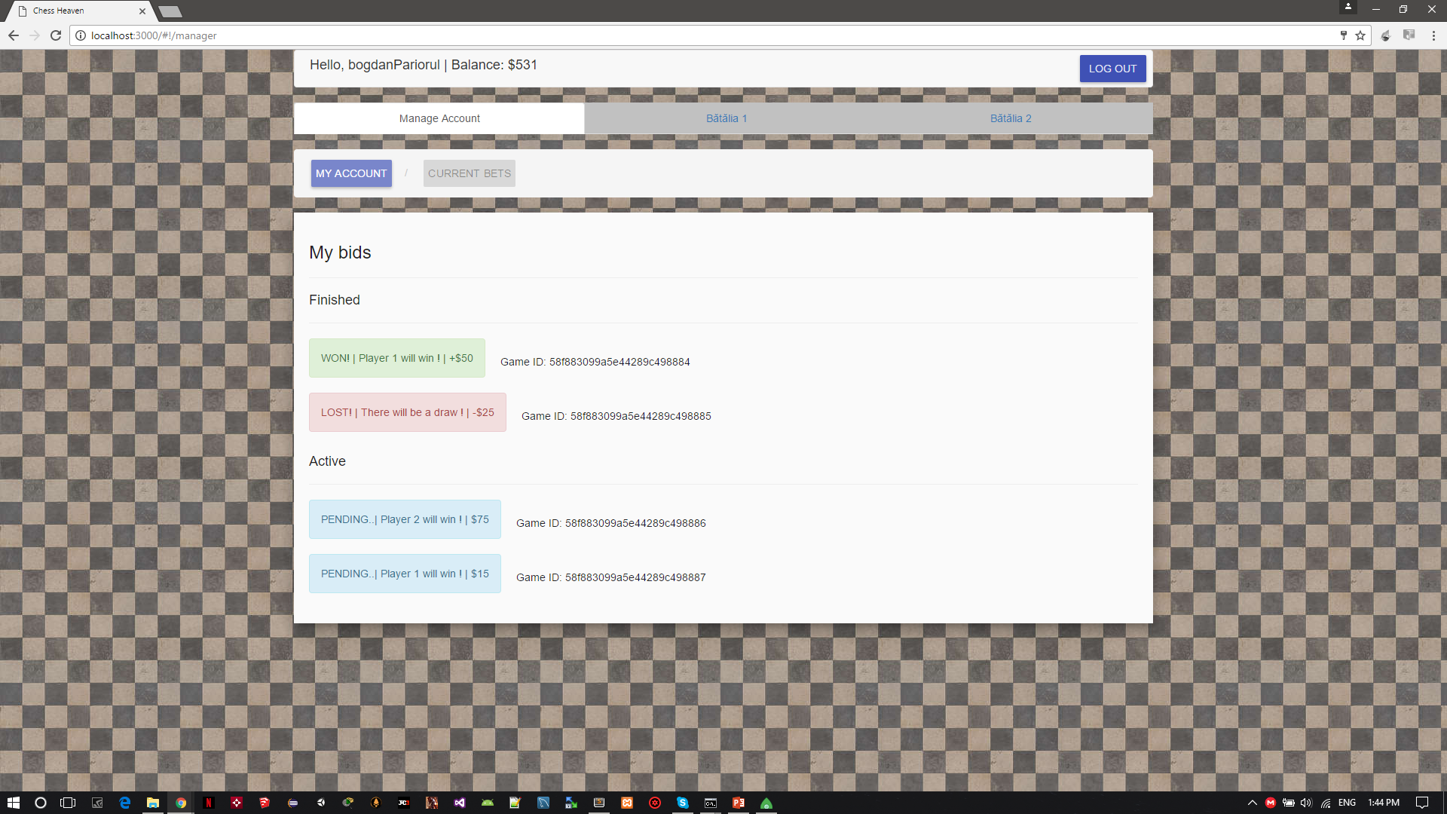
Manage Account Page
“My account” Tab, from this view you can update your account money, for FREEEE!!!
“Current Bets” Tab, here you can view your current bets.

Slide 11
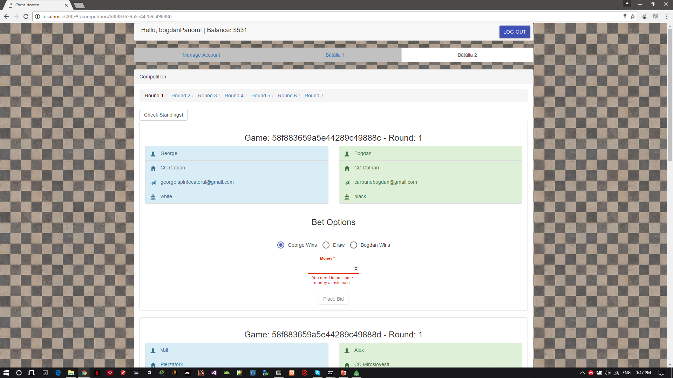
Competition Page
Here you can view all games from selected competition, also you can bet a certain amount of money for it. When a manager end the game you bet on it, you will receive your prize doubled if you won, or remain with your prize money lost.

Slide 12
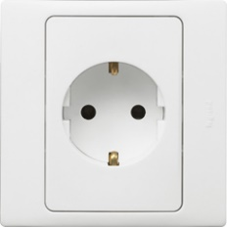
Application Features
After you login, your account will stay logged in even if you close the browser’s window thanks to angular js’s local storage module.
Adding competitions, or placing bets updates the application on every device on which it is running. Sockets do the whole thing!
Sooo…use sockets!
Marvelous design for inputs, buttons using Angular Material .

Slide 13
END ☹
Developed by:
-Full Stack JS Team
-Cărbune Bogdan

